Slide 1
Functions
Introduction to Functions | Returning a Value | Function Expression and Anonymous Functions | Arrow Functions |
Notes:
Welcome to our lecture on some more functions in JavaScript. In this lecture we will go through introduction to functions, how to return values using functions, function expressions and anonymous functions, and arrow functions. Let’s start our lecture.

Slide 2
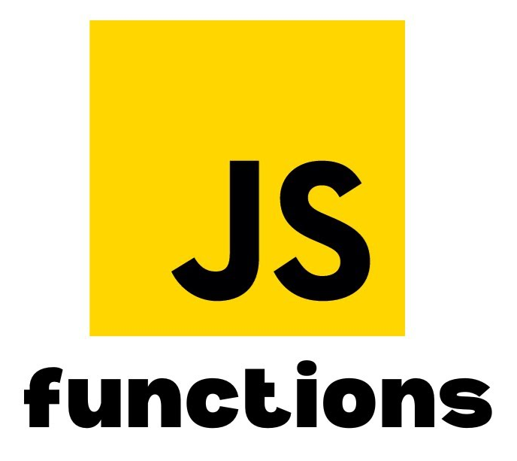
Introduction to Functions
Definition: A function is a named group of statements in JavaScript, declared using the function keyword, a name, parameters in (), and statements inside {}.
Parameters: Parameters are variables that provide input to the function when it is called.
Function Call: Calling a function (function call) executes its statements, with arguments passed to its parameters.
Notes:
A function in JavaScript is a named group of statements, defined using the function keyword, a name, parameters in parentheses, and code inside curly braces. Parameters are variables that provide input to the function when it is called. Calling a function executes its code, with arguments passed to its parameters, making functions a key tool for organizing and reusing code efficiently.

Slide 3
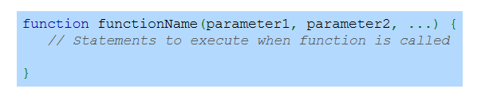
Function Declaration Syntax
Notes:
The function declaration syntax in JavaScript starts with the function keyword, followed by the function name and a list of parameters enclosed in parentheses. Inside curly braces, you define the statements that will execute when the function is called. This structure allows you to create reusable blocks of code that can perform specific tasks whenever invoked.

Slide 4
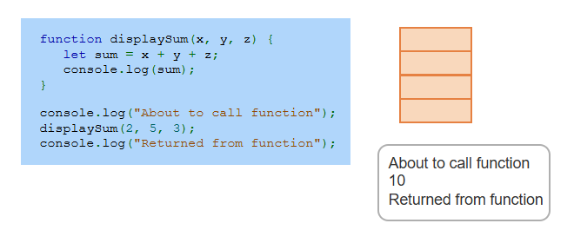
Example
Notes:
This example demonstrates a simple function called displaySum that takes three parameters x, y, and z. It calculates their sum, assigns it to the variable sum, and logs the result to the console. The function is called with arguments 2, 5, and 3. Surrounding console.log statements indicate when the function is called and when it returns, showing how functions execute in sequence.

Slide 5
Returning a Value
A function can return a single value using the return statement.
If a function does not include a return statement, it automatically returns undefined.
The return statement ends the function execution and sends the specified value back to the caller.
Notes:
In JavaScript, functions can return a single value using the return statement. If no return statement is included, the function automatically returns undefined. The return statement ends the function's execution and sends the specified value back to the caller. This mechanism allows functions to provide results that can be used in other parts of the program.

Slide 6
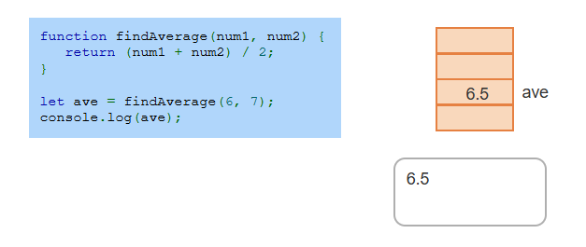
Example
Notes:
This example defines a function called find Average that takes two parameters, num1 and num2. The function calculates the average of the two numbers by summing them and dividing by two, then returns the result. The returned value is stored in the variable AVE, which is logged to the console. When called with arguments 6 and 7, the function returns 6.5, demonstrating the use of return values.

Slide 7
Function expressions and anonymous functions
Function Expressions: JavaScript functions can be assigned to a variable using a function expression, which is like a function declaration.
Anonymous Functions: A function without a name is called an anonymous function and is commonly used in arrays and event handlers.
Key Difference: In function expressions, the function name is optional, unlike in function declarations.
Notes:
In JavaScript, functions can be assigned to variables using function expressions, which are like function declarations. Anonymous functions are functions without a name, often used in arrays and event handlers. The key difference is that function expressions allow the function name to be optional, making them more flexible than traditional function declarations.

Slide 8
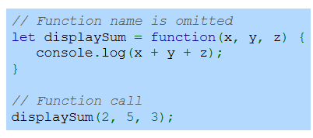
Example
Notes:
This example shows a function expression where the function is assigned to the variable display Sum. The function takes three parameters, x, y, and z, and calculates their sum, logging the result to the console. Note that the function has no name, making it an anonymous function. The function is called using display Sum with arguments 2, 5, and 3, which outputs the sum 10 to the console.

Slide 9
Arrow Functions
Definition: An arrow function is an anonymous function written with the => symbol for a more concise syntax.
Syntax: Parameters are listed on the left of the =>, and the right side contains either a single expression or multiple statements enclosed in {}.
Usage: Arrow functions are compact and commonly used in modern JavaScript for cleaner, more readable code.
Notes:
Arrow functions are anonymous functions in JavaScript, written using the arrow symbol for a concise syntax. Parameters are placed on the left of the arrow, while the right side holds a single expression or multiple statements inside curly braces. Compact and easy to read, arrow functions are widely used in modern JavaScript for cleaner, more efficient code.

Slide 10

Arrow Function Declaration
With Single parameter
With Multiple parameters
Notes:
There are two forms of arrow function declaration. For a single expression, the syntax places parameters on the left and the expression on the right of the arrow. For multiple statements, the parameters are followed by curly braces containing the statements. Arrow functions are flexible, allowing for clean and concise code, whether handling simple expressions or complex logic.

Slide 11
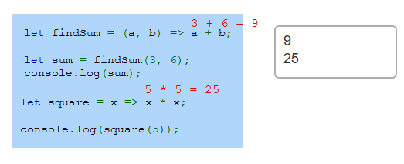
Example
Notes:
This example demonstrates the use of arrow functions. The find Sum function takes two parameters, adds them, and returns the result. It is called with 3 and 6, returning 9, which is logged to the console. The square function takes one parameter and returns its square. It is called with 5, returning 25. Arrow functions provide a concise way to define reusable and simple operations. Thanks for watching the lecture.

